Slide 1
December 2014
Smart Irrigation
Team iSlugs:
Alex Mitchell, Evan Hughes, Alesandra Roger, Ian Hamilton, Rashad Kayed, Yugraj Singh
IDEASS Smart Irrigation Project:
Kevin Bell: IDEASS advisor
Tamara Ball: associate IDEASS advisor

Slide 2
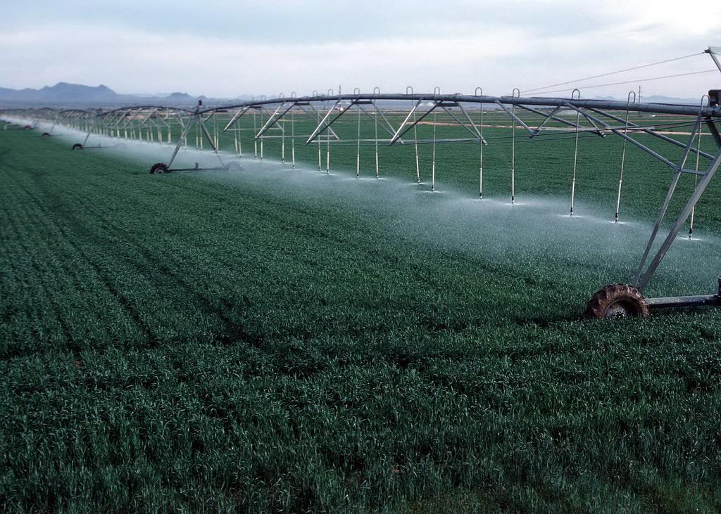
Problem/Application:
Goal: Design a system architecture that interfaces with an autonomous microcontroller and wireless chip allowing farmers to accurately water their plants based off of the soil moisture levels collected by a water sensor in the ground.
Technologies Used:
Arduino Uno
XBee Wireless Chip
Humidity Sensor
Project Management Techniques Used:
Tracking estimates of project duration
Creating and delegating tasks
Project Deliverables
Technical Process Plan
Test Planning

Slide 3
Challenges & Accomplishments
Biggest Challenges:
Building the entire system from scratch with poorly constrained hardware requirements.
Programming the XBee chip and interfacing it with Arduino.
Finding a water sensor with comprehensive documentation.
B. Biggest Accomplishments:
We learned how to use the Arduino Uno and write libraries for the Arduino environment.
We figured out how to store data without creating memory leaks in the Arduino environment (which make for very confusing runtime errors).
We created a working system that reads in data, transmits data wirelessly, and stores the data.
We created a flexible architecture which easily allows future developers to add features.

Slide 4
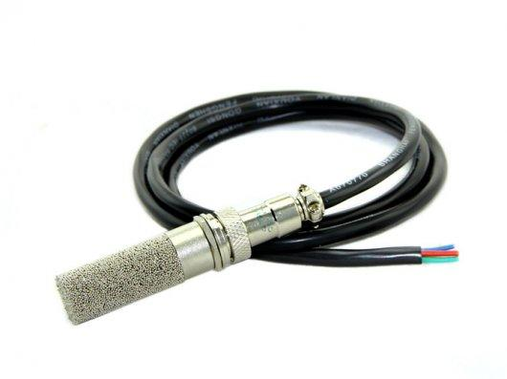
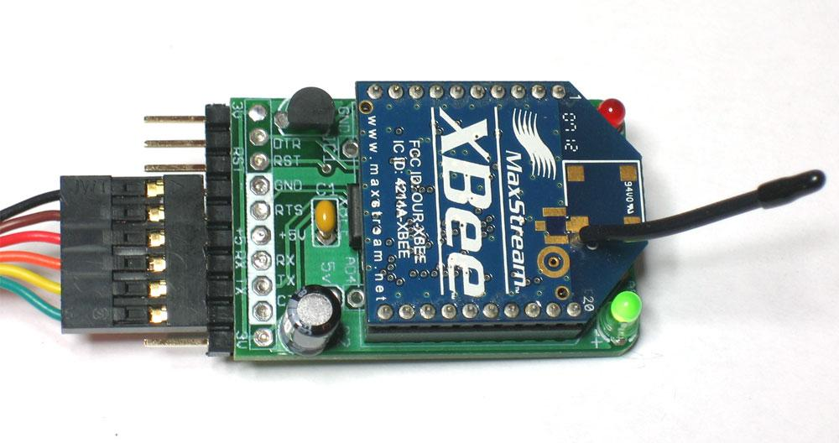
What We Did and Didn’t Enjoy
Enjoyed:
Learning about and working with hardware we had never dealt with
(Arduino, XBee chip and Moisture Sensor).
Designing a system architecture using arduino libraries.
Working with the group and pairing on some of the coding.
Didn’t enjoy:
All the reports we were required to do.
Lack of timely correspondence with our advisor.
Having three Sprints instead of four.
Sitting idle while waiting for hardware issues

Slide 5

Lessons Learned
What worked:
Having a plan before working.
Strong communication between team members.
Having hardware documentation to guide in the process of building out system.
What didn’t work:
Showing up late to meetings.
Designing code without much sense of direction.
Staying on target during iterations.

Slide 6
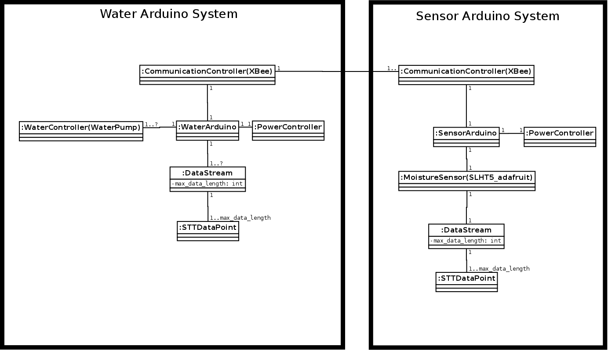
Configuration Diagram

Slide 7
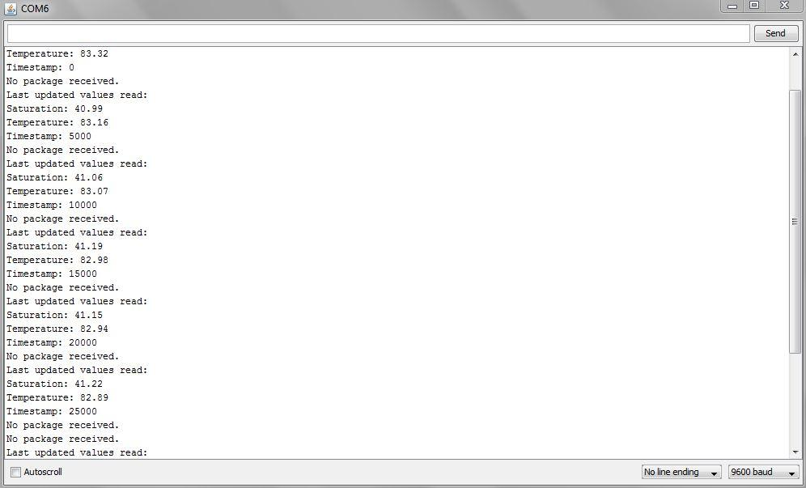
Sample Output
Saturation Level of moisture in soil
Temperature in Fahrenheit
Time at which values were taken

Slide 8
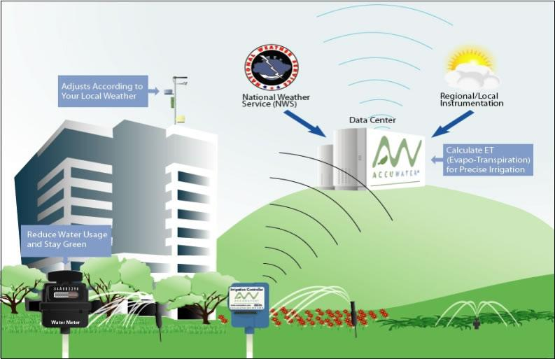
Thanks!
We hope we gave you something cool to think about!

